Slide 1

Classifying Bean Types Using Decision Tree
Patrick Krol
Cs 422
Notes:
And im sorry if i refer to them as bean trees because that is what i kept calling them throughout my work

Slide 2
What is the Problem?
Given a sizeable database consisting of seven bean types and various measurements of size, shape, ect., can one accurately classify each bean type using decision trees?

Slide 3
Why Beans?
Little database manipulation needed in order to make use of the data
Classification is a useful skill and this database was designed with that in mind
Very open-ended
Original authors had quality of beans in question in mind
Notes:
What this means is that the database was already very cleaned and organized, which makes it a lot easier to work on right away as I am sure many of you know.

Slide 4
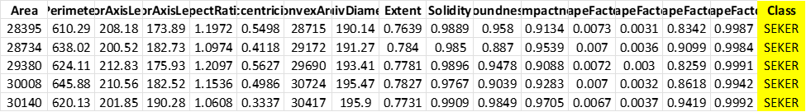
What does the Data Look Like?
16 features + Bean type (Class)
7 Types of beans: Seker, Barbuny, Bombay, Cali, Horoz, Sira, Dermason
Photographed with high res camera
Measurements taken with Computer Vision System
https://archive.ics.uci.edu/ml/datasets/Dry+Bean+Dataset

Slide 5
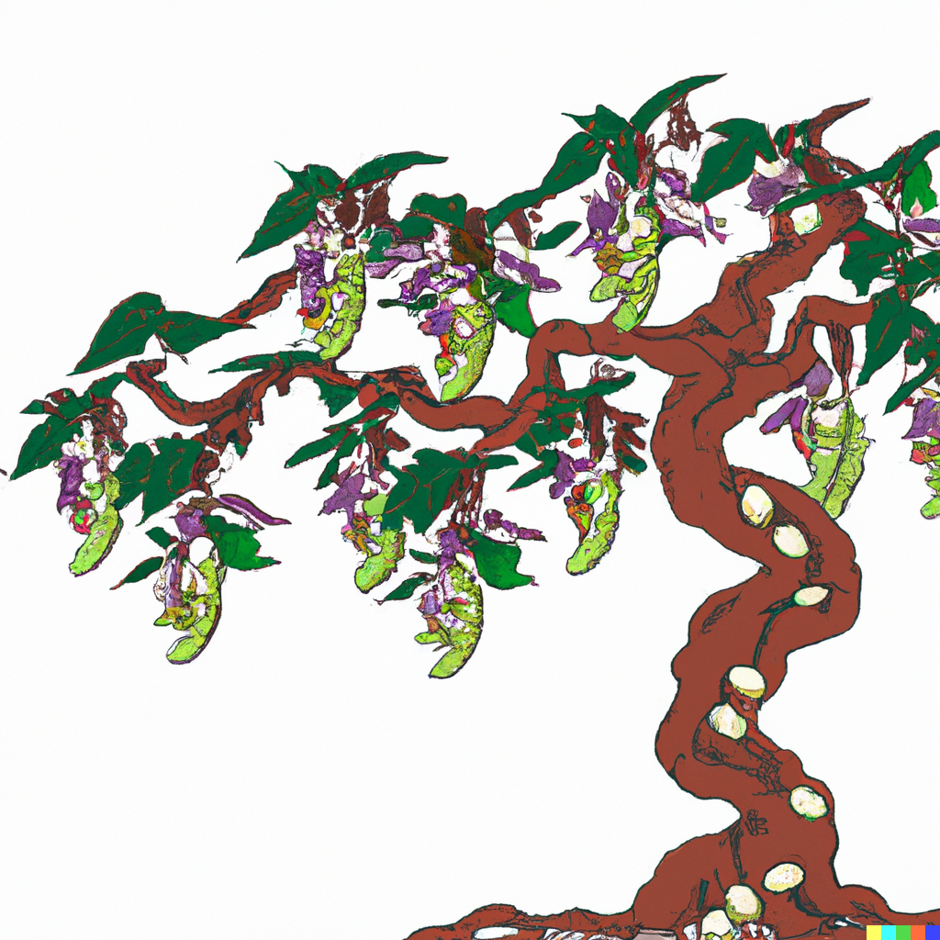
Methodology
Decided to move forward using the decision tree method of classification
Using python SciKitLearn DecisionTreeClassifier
Able to support multiclass classification
Using 80/20 split
Notes:
No rhyme or reason as to why I wanted to use the decision tree to solve this problem other than I thought bean trees was a fun thing to think about.

Slide 6
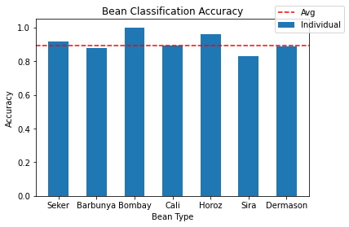
Results
Overall Accuracy: 89.5%
Seker: 91.5%
Barbunya: 87.7%
Bombay: 100%
Cali: 89.1%
Horoz: 95.9%
Sira: 83.0%
Dermason: 88.8%

Slide 7
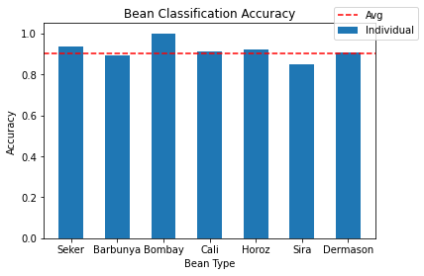
Results/Adjusted Tree
Overall Accuracy: 90.3%
Seker: 93.4%
Barbunya: 89.1%
Bombay: 100%
Cali: 91.1%
Horoz: 92.3%
Sira: 84.7%
Dermason: 90.5%
Notes:
I noticed that a lot of the averages of the attributes held similar values so
Using the trial and error method, I removed features/attributes to see if i could increase the overall accuracy of the bean tree

Slide 8
Individual Bean Trees
Seker: 98.1%
Barbunya: 98.1%
Bombay: 100%
Cali: 97.6%
Horoz: 98.0%
Sira: 93.5%
Dermason: 94.7%
Better for telling what a bean isn’t
Beans could be classified as several beans or no beans
Notes:
Seker can tell to a 98.1% accuracy whether or not a bean is a seker bean. Ect.
A way around it would be to look in to which bean type the bean is question is closest to

Slide 9
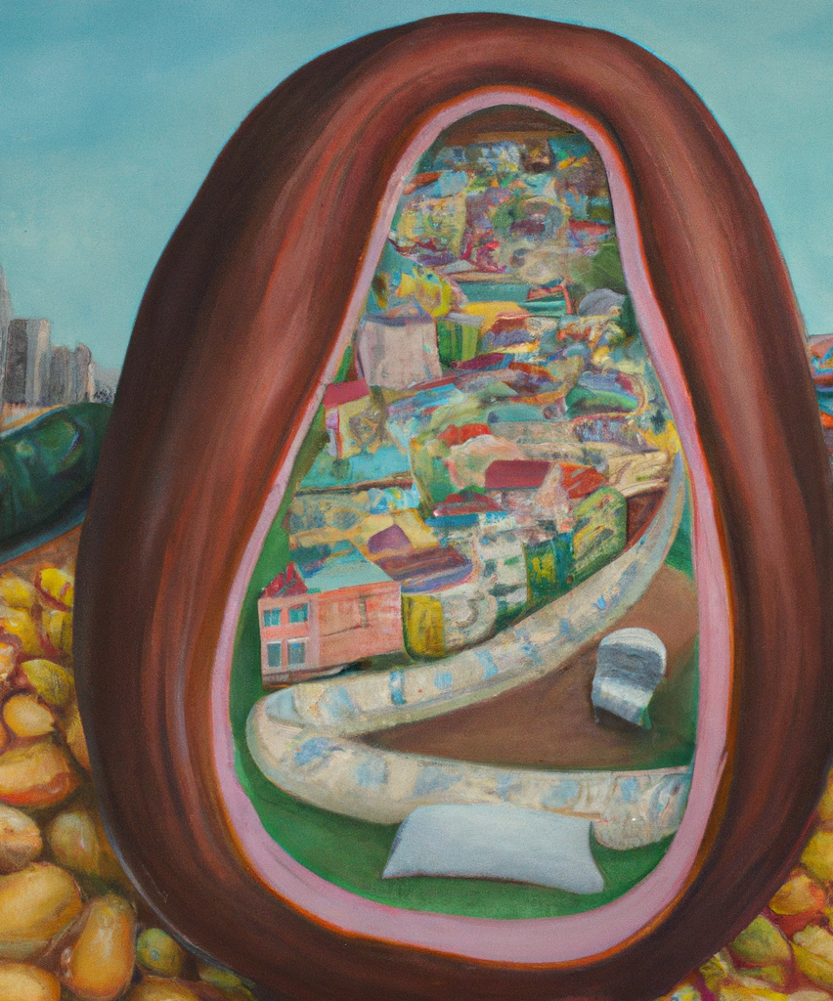
Experiences/Conclusion
Results differ slightly from Dry Bean Article
Was not as straightforward as I thought
Future work:
Which beans get mistaken for which?
Notes:
While the results differ from the author’s results of 92.5%, I am happy with my result as my main goal was to simply explore classification as it is something i have never delved into before
I went down many rabbit holes in my mind thinking about all the nuances of the statistics associated with this project. This cost a lot of time. Take for example the individual bean trees. They do give info, but together they are not all that useful
I would like to figure out which beans get mistaken for which and then find a way to counter that to increase the accuracy

Slide 10
References
Art from:
https://openai.com/dall-e-2/
Dry Bean Dataset:
https://archive.ics.uci.edu/ml/datasets/Dry+Bean+Dataset
Article on Dry Bean Dataset:
https://www.sciencedirect.com/science/article/abs/pii/S0168169919311573?via%3Dihub

